Slide 1
Software Verification Validation and Testing
Prepared by : Neha Tripathi

Slide 2
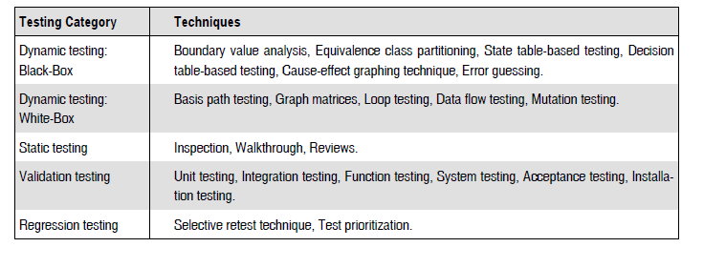
Testing techniques

Slide 3
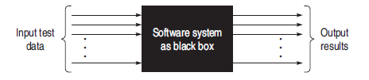
Dynamic Testing: Black-Box Testing Techniques
Black-box technique considers only the functional requirements of the software or module. Therefore, this is also known as functional testing.
The software system is considered as a black box, taking no notice of its internal structure, so it is also called as black-box testing technique.
In black-box technique, test cases are designed based on functional specifications.
Input test data is given to the system, which is a black box to the tester, and results are checked against expected outputs after executing the software

Slide 4
Black-box testing attempts to find errors in the following categories:
To test the modules independently
To test the functional validity of the software so that incorrect or missing functions can be recognized
To look for interface errors
To test the system behavior and check its performance
To test the maximum load or stress on the system
To test the software such that the user/customer accepts the system within defined acceptable limits

Slide 5
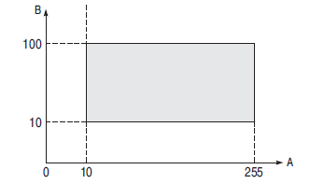
BOUNDARY VALUE ANALYSIS (BVA)
An effective test case design requires test cases to be designed such that they maximize the probability of finding errors.
In BVA technique, test cases designed with boundary input values have a high chance to find errors.
Boundary means the maximum or minimum value taken by the input domain.
For example, if A is an integer between 10 and 255, then boundary checking can be on 10(9,10,11) and on 255(256,255,254).
Similarly, B is another integer variable between 10 and 100, then boundary checking can be on 10(9,10,11) and 100(99,100,101)

Slide 6
Methods of BVA
BOUNDARY VALUE CHECKING (BVC)
ROBUSTNESS TESTING METHOD
WORST-CASE TESTING METHOD

Slide 7
BOUNDARY VALUE CHECKING (BVC)
In this method, the test cases are designed by holding one variable at its extreme value and other variables at their nominal values in the input domain.
The variable at its extreme value can be selected at:
(a) Minimum value (Min)
(b) Value just above the minimum value (Min+ )
(c) Maximum value (Max)
(d) Value just below the maximum value (Max−)
It can be generalized that for n variables in a module, 4n + 1 test cases can be designed with boundary value checking method.

Slide 8
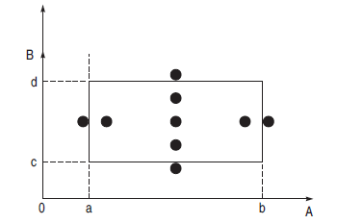
Example : BVC
Let us take the example of two variables, A and B. If we consider all the above combinations with nominal values, then following test can be designed:
Anom, Bmin
Anom, Bmin+
3. Anom, Bmax
4. Anom, Bmax–
5. Amin, Bnom
6. Amin+, Bnom
7. Amax, Bnom
8. Amax–, Bnom
9. Anom, Bnom
Fig. : Boundary value checking

Slide 9
ROBUSTNESS TESTING METHOD
The idea of BVC can be extended such that boundary values are exceeded as:
A value just greater than the Maximum value (Max+)
A value just less than Minimum value (Min−)
When test cases are designed considering the above points in addition to BVC, it is called robustness testing.
Example: Let us take the previous example again. Add the following test cases to the list of 9 test cases designed in BVC:
10. Amax+, Bnom
11. Amin–, Bnom
12. Anom, Bmax+
13. Anom, Bmin–
It can be generalized that for n input variables in a module, 6n + 1 test cases can be designed with robustness testing.

Slide 10
WORST-CASE TESTING METHOD
We can again extend the concept of BVC by assuming more than one variable on the boundary. It is called worst-case testing method.
Again, take the previous example of two variables, A and B. We can add the following test cases to the list of 9 test cases designed in BVC as:
10. Amin, Bmin 11. Amin+, Bmin
12. Amin, Bmin+ 13. Amin+, Bmin+
14. Amax, Bmin 15. Amax–, Bmin
16. Amax, Bmin+ 17. Amax–, Bmin+
18. Amin, Bmax 19. Amin+, Bmax
20. Amin, Bmax– 21. Amin+, Bmax–
22. Amax, Bmax 23. Amax–, Bmax
24. Amax, Bmax– 25. Amax–, Bmax–
It can be generalized that for n input variables in a module, 5n test cases can be designed with worst-case testing.

Slide 11
Example: BVA
A program reads an integer number within the range [1,100] and determines whether it is a prime number or not. Design test cases for this program using BVC, robust testing, and worst-case testing methods.

Slide 12
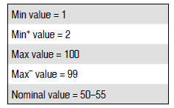
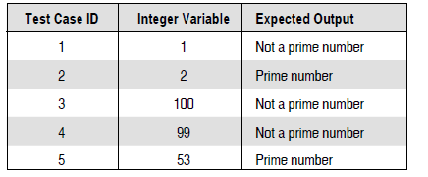
Solution:
Test cases using BVC Since there is one variable, the total number of test cases will be 4n + 1 = 5.
The set of minimum and maximum values is shown below:
Using these values, test cases can be designed as shown below:

Slide 13
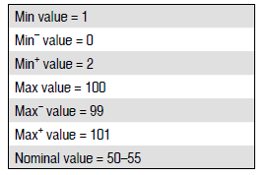
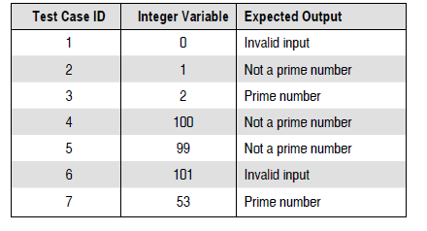
(b) Test cases using robust testing. Since there is one variable, the total number of test cases will be 6n + 1 = 7. The set of boundary values is shown below:
Using these values, test cases can be designed as shown below:

Slide 14
(c) Test cases using worst-case testing
Since there is one variable, the total number of test cases will be 5n = 5. Therefore, the number of test cases will be same as BVC.

Slide 15
Example: BVA
A program computes a^{b} where a lies in the range [1,10] and b within [1,5]. Design test cases for this program using BVC, robust testing, and worst-case testing methods.

Slide 16
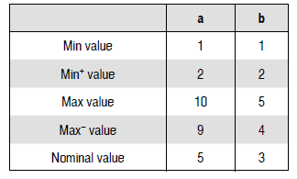
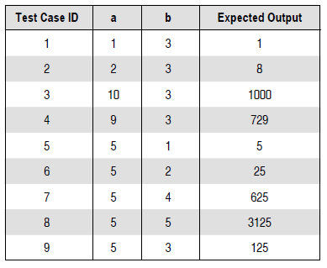
Solution:
Test cases using BVC Since there are two variables, a and b, the total number of test cases will be 4n + 1 = 9. The set of boundary values is shown below:
Using these values, test cases can be designed as shown below:

Slide 17
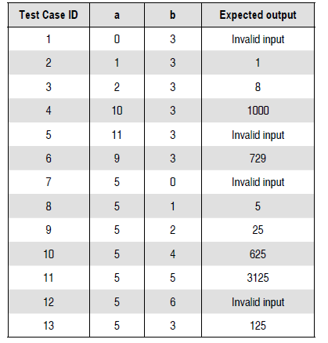
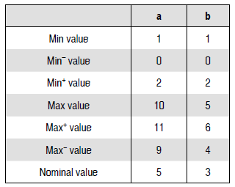
(b) Test cases using robust testing Since there are two variables, a and b, the total number of test cases will be 6n + 1 = 13. The set of boundary values is shown fig. (left):
Using these values, test cases can be designed as shown in fig. (right):

Slide 18
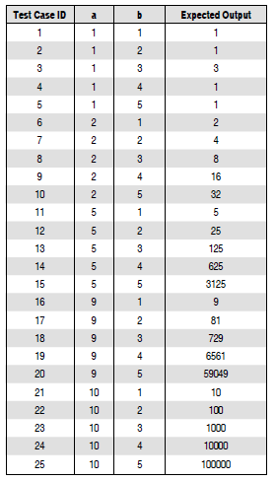
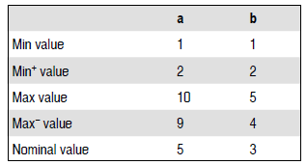
(c) Test cases using worst-case testing Since there are two variables, a and b, the total number of test cases will be 5n = 25.
The set of boundary values is shown in fig.(left):
There may be more than one variable at extreme
values in this case. Therefore, test cases can be
designed as shown in fig. (right):

Slide 19
Thank you!

